Slide 1
Logistics Optimisation for Delivery Routes – FEDX
Using SQL
Name: Sarthak Ghodmare Date : December 2025
Tools used : SQL Workbench
Project Video Link:
Vedio 1: https://screenrec.com/share/5ntAET3Im8
Vedio 2: https://screenrec.com/share/tvd5xVmEUn

Slide 2
Project Overview
FedEx, one of the world’s largest logistics and courier service providers, operates an extensive
global air and ground transportation network, connecting more than 220 countries and
territories through major hubs in Memphis, Dubai, Singapore, Paris, and London. This project applies SQL-based analytics to evaluate and optimise logistics performance across routes, warehouses, and delivery agents.
But, Currently, FedEx’s logistics operations face challenges in:
● Identifying the root causes of transit and delivery delays (e.g., customs clearance,
weather disruptions, route congestion).
● Optimizing international and regional routes for faster, more cost-effective deliveries.
● Improving shipment efficiency, warehouse throughput, and agent performance
using data-driven insights.
Project Objective:
Build a SQL-driven logistics analytics system to analyze shipment performance, optimize routes,
and enhance delivery efficiency across FedEx’s global network.
The project aims to:
● Identify delay patterns and operational inefficiencies.
● Optimize hub and route combinations for improved transit times.
● Analyze agent- and warehouse-level performance.

Slide 3
Dataset Summary
Table Name | Key Columns | Include
Fedex_Orders | Order_ID, Customer_ID, Order_Date, Route_ID, Warehouse_ID | The Orders dataset contains order-level delivery details including order date, route, warehouse, and payment type.
Fedex_Routes | Route_ID, Source/Destination City, Distance_KM, Avg_Transit_Time | The Routes dataset includes route-level transportation details, covering the source and destination cities, countries, total distance, and average transit time (in hours).
Fedex_Warehouse | Warehouse_ID, City, Country, Capacity_per_day | The Warehouses dataset provides location-level information about FedEx’s major hubs and sortation centers.
Fedex_Delivery Agents | Agent_ID, Agent_Name, Zone, Experience_Years, Avg_Rating | The Delivery Agents dataset contains agent-level performance data, including agent ID, name, assigned zone and country, experience, and customer rating.
Fedex_Shipments | Shipment_ID, Order_ID, Agent_ID, Pickup/Delivery_Date, Delay_Hours, Status | The Shipments dataset includes shipment-level tracking information with timestamps for pickup and delivery, delay duration, and feedback ratings.

Slide 4
CONTENTS:
Task 1 – Data Cleaning & Preparation
Task 2 – Delivery Delay Analysis
Task 3 – Average Transit Time per Route
Task 4 – Warehouse Performance Analysis.
Task 5 – Delivery Agent Performance
Task 6 – Shipment Tracking Analysis
Task 7 – KPI Reporting
Task 8 – Final Recommendations

Slide 5
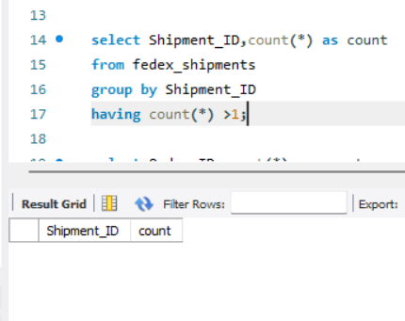
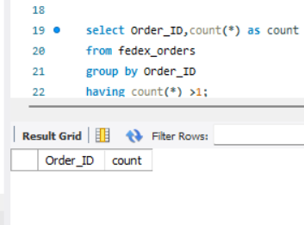
Task 1 – Data Cleaning & Preparation
1. Identify and delete duplicate Order_ID or Shipment_ID records.
Shipment table
Order table
Findings: No duplicates found in Orders and Shipments table .Therefore no need to write and delete the query.

Slide 6
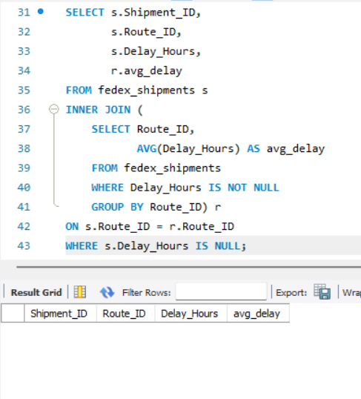
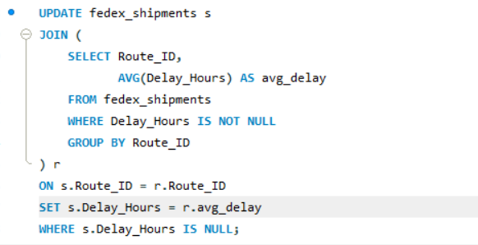
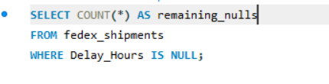
Task 1 – Data Cleaning & Preparation
2. Replace NULL Delay_Hours with Average Delay per Route_ID
The preview query returned zero rows, which confirms there are no missing delay values. Since there is nothing to update, running the UPDATE query is not required.

Slide 7
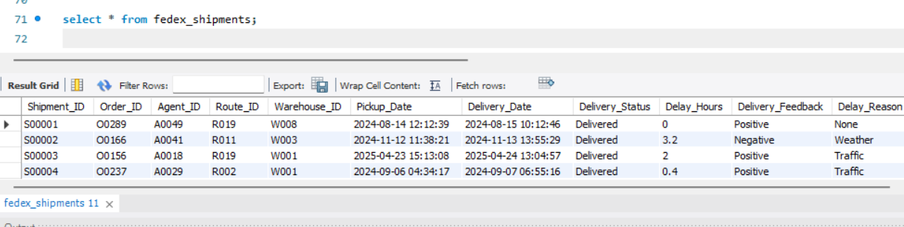
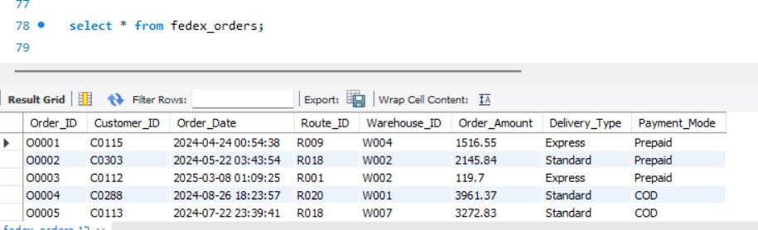
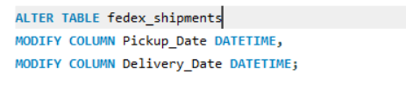

Task 1 – Data Cleaning & Preparation
3. Convert All Date Columns to YYYY-MM-DD HH:MM:SS Format
Order table
Shipment table
First, the existing date columns were verified to check their data type and format.
Since the columns were already in DATETIME (YYYY-MM-DD HH:MM:SS) format, no ALTER operation was required.
This confirms that the database already follows proper date standardization.

Slide 8
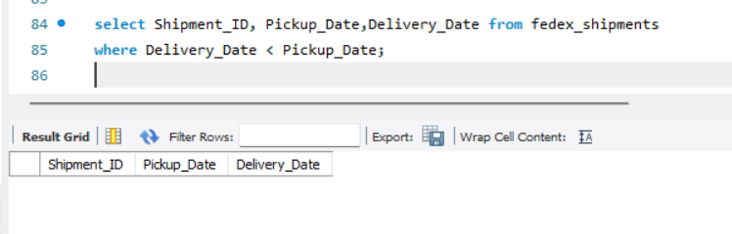
Task 1 – Data Cleaning & Preparation
4. Ensure No Delivery_Date Occurs Before Pickup_Date
A validation query was executed to identify shipments where the Delivery Date occurs before the Pickup Date.
The query returned zero rows, indicating no invalid date sequences.
This confirms that all shipments follow correct chronological order, ensuring data accuracy.

Slide 9
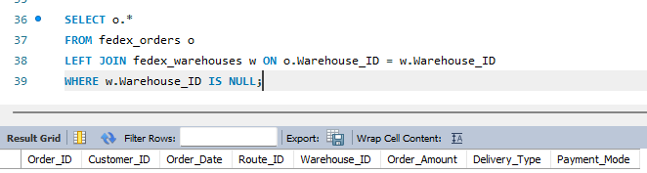
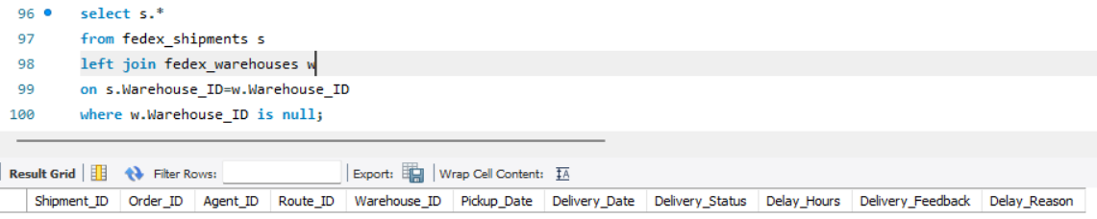
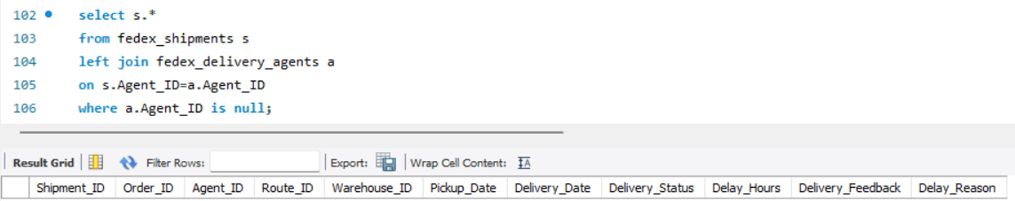
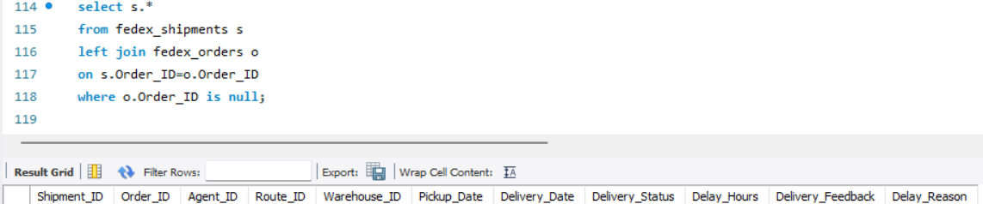
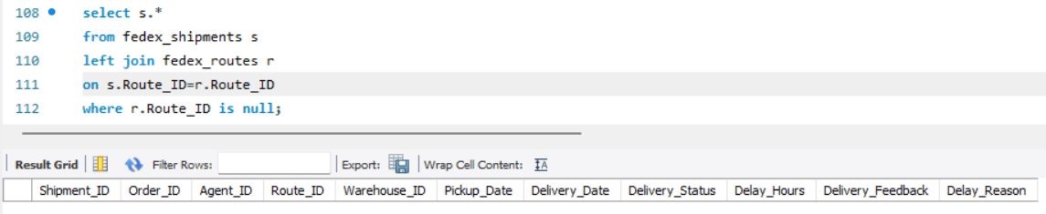
Task 1 – Data Cleaning & Preparation
5. Validate referential integrity between Orders, Routes, Warehouses, and Shipments.
1. Orders → Warehouses
4. Shipments → Warehouses
2. Shipments → Agents
5.. Shipments → orders
3. Shipments → Routes
Referential integrity was validated using INNER/LEFT JOIN checks between Orders, Routes, Warehouses, and Shipments.
The validation queries returned zero rows, indicating no missing or orphan records.
This confirms that all foreign key relationships are correctly maintained across the databases

Slide 10
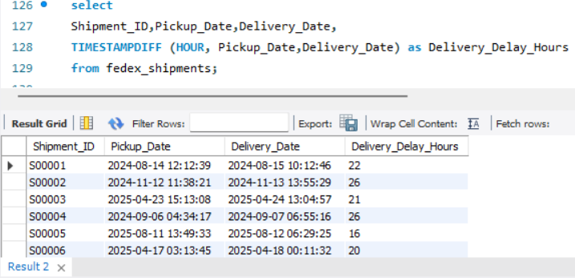
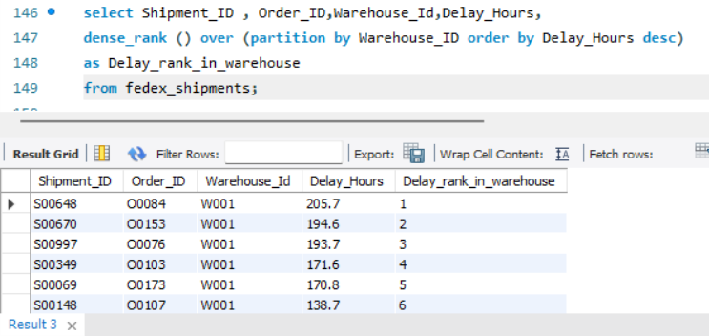
Task 2 – Delivery Delay Analysis
1. Calculate delivery delay (in hours) for each shipment using Delivery_Date –Pickup_Date
.
3. Use SQL window functions to rank shipments by delay within each Warehouse_ID.
Shipments are ranked within each warehouse based on delivery delay, with Rank 1 showing the highest delay.
In Warehouse W001, a few shipments have very high delays, showing uneven delivery performance.
Delivery delay is calculated by finding the time difference (in hours) between Pickup Date and Delivery Date for each shipment.

Slide 11
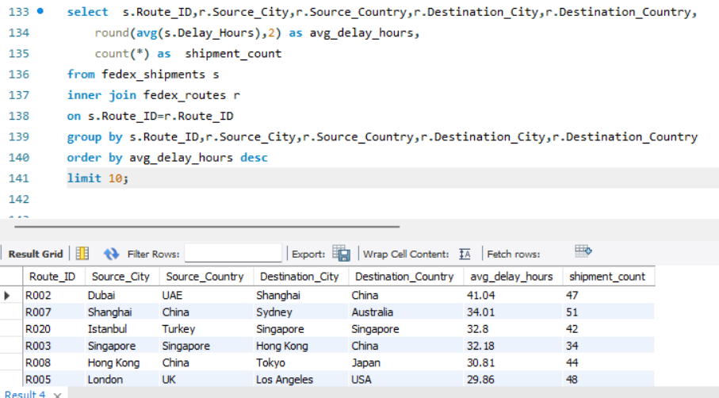
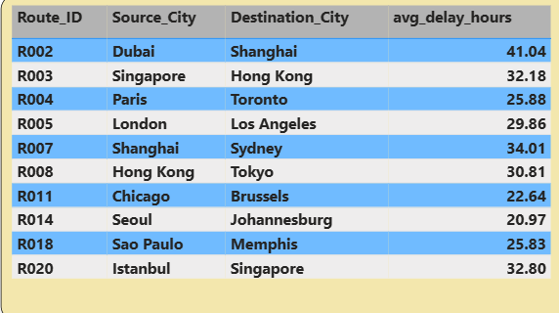
Task 2 – Delivery Delay Analysis
2. Find the Top 10 delayed routes based on average delay hours.
Findings :
1.Dubai → Shanghai is the most delayed route, with the highest average delay hours(41.04).
2. Most of the top 10 delayed routes are in the Asia–Pacific region, showing heavy traffic and customs delays

Slide 12
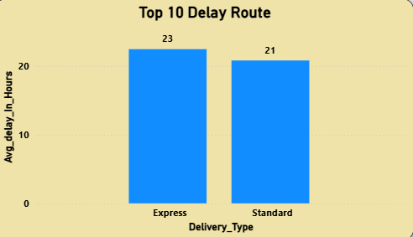
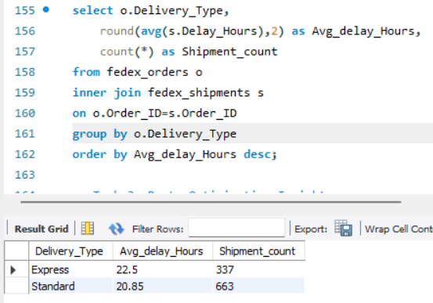
Task 2 – Delivery Delay Analysis
4. Average delay per Delivery_Type (Express vs Standard)
Findings :
1. Express delivery has a higher average delay (23 hours) compared to Standard delivery (21 hours).
2. This shows that Express shipments are more affected by delays, possibly due to tighter delivery timelines.
3. Standard delivery is slightly more reliable in terms of average delay.

Slide 13
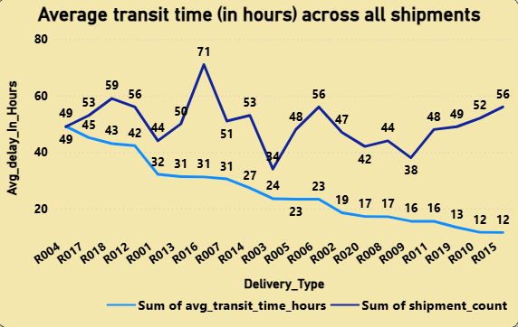
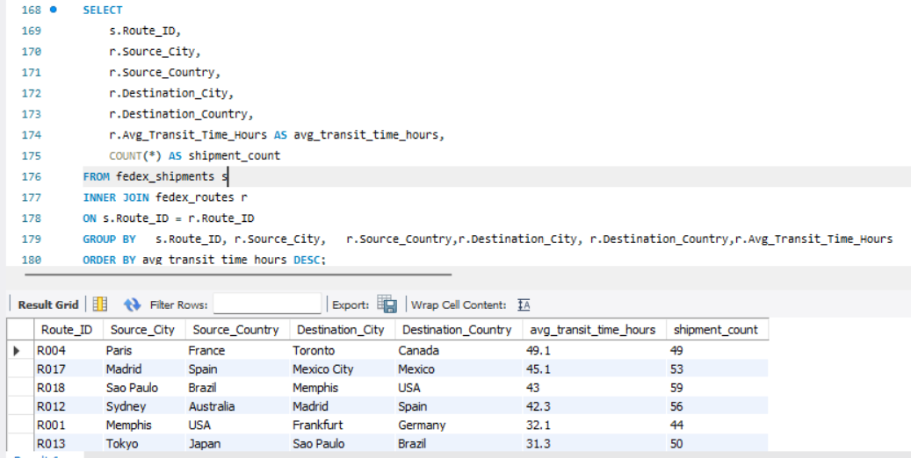
Task 3 – Average Transit Time per Route
1. Average transit time (in hours) across all shipments.
Findings :
1. Paris → Toronto has the highest average transit time at 49.1 hours, making it the slowest route But shipment_count is 49...
2. Madrid → Mexico City and São Paulo → Memphis also show long transit times(45.1 hours), indicating delays on long-distance routes But shipment_count is 53.
3. Amsterdam → IStanbul has the lowest average transit time (11.5hours), showing comparatively better route efficiencyBut shipment_count is 56.

Slide 14
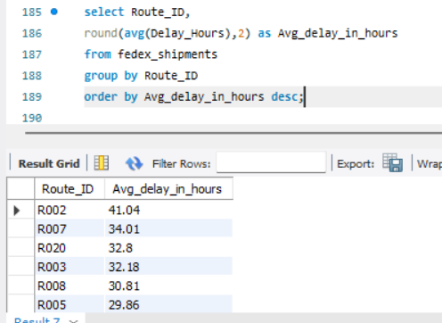
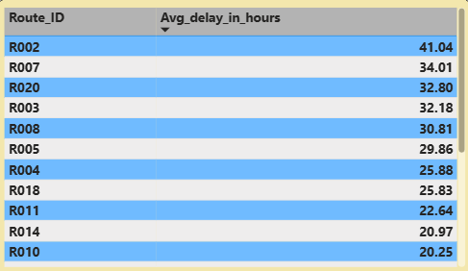
Task 3 – Average Transit Time per Route
2. Average Delay per Route
Findings :Route R002 has the highest average delay (41.04 hours), followed by R007 and R020, indicating these routes face the most significant delivery delays overall.

Slide 15
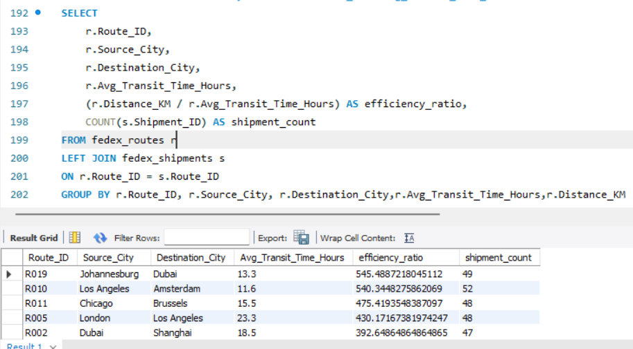
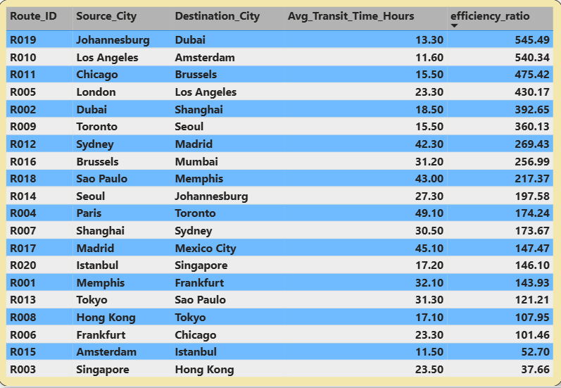
Task 3 – Average Transit Time per Route
3. Distance-to-time efficiency ratio = Distance_KM / Avg_Transit_Time_Hours
Findings :
.Route R019 (Johannesburg → Dubai) is the most efficient route with the highest efficiency ratio (545.49), indicating maximum distance covered per hour.
.Routes R010 and R011 also show very high efficiency (above 475), reflecting fast long-haul performance.
.Route R003 (Singapore → Hong Kong) has the lowest efficiency ratio (37.66), making it the least time-efficient route.

Slide 16
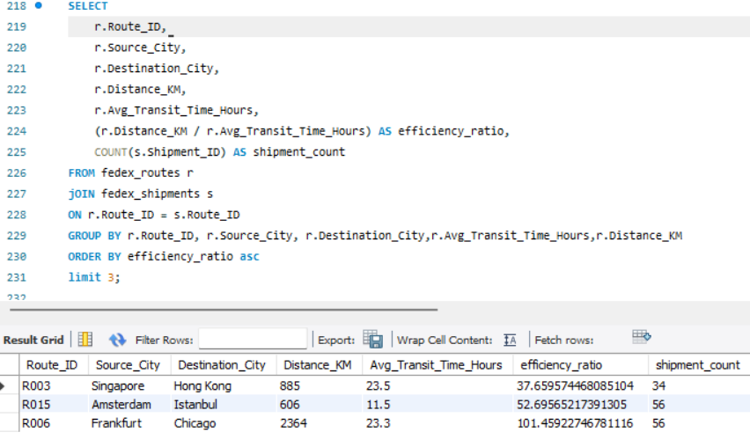
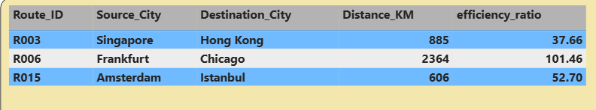
Task 3 – Average Transit Time per Route
4. Identify 3 routes with the worst efficiency ratio (lowest distance-to-time).
Findings :
1. Singapore → Hong Kong (R003) is the least efficient route, with the lowest efficiency ratio (33.66), indicating significant delays despite a very short distance of 885 km.
2. Amsterdam → Istanbul (R015) also shows inefficiency, where a short 606 km route still requires comparatively high transit time, suggesting operational or regional bottlenecks.

Slide 17
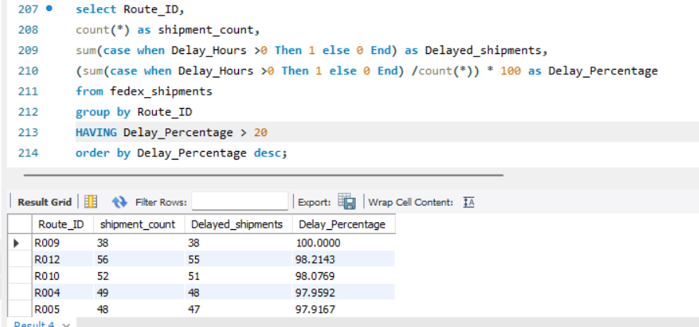
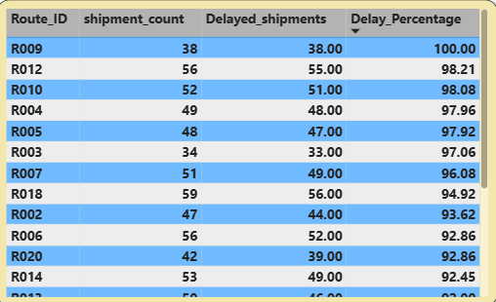
Task 3 – Average Transit Time per Route
5. Find routes with >20% of shipments delayed beyond expected transit time.
Findings :
Route R009 shows the worst performance, with 100% of shipments delayed, indicating a critical operational issue.
Routes R012 and R010 also have extremely high delay rates (around 98%), showing consistent failure to meet expected transit times.
Several other routes (such as R004, R005, and R003) have delay percentages above 97%, highlighting widespread reliability problems across these routes.

Slide 18
Task 3 – Average Transit Time per Route
6. Recommendations for Route Optimization
Recommendations :
Fix critical delay routes first (R009, R012, R010): These routes show ~98–100% delayed shipments and require immediate corrective action.
Optimize least efficient routes (R003, R015, R006): Low distance-to-time efficiency indicates operational bottlenecks despite short/medium distances.
Rework long transit routes (Paris → Toronto, Madrid → Mexico City, São Paulo → Memphis): High average transit times suggest routing or hub inefficiencies.
Replicate high-efficiency route practices (R019, R010, R011): Apply their scheduling, carrier selection, and transit strategies to poor-performing routes.
Improve hub and customs handling: High delays across multiple routes indicate congestion or clearance issues at intermediate hubs.
Route rationalization: Replace or reroute consistently underperforming corridors with alternative paths or logistics partners to improve reliability.

Slide 19
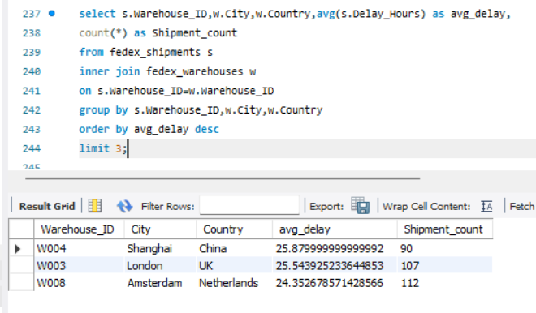
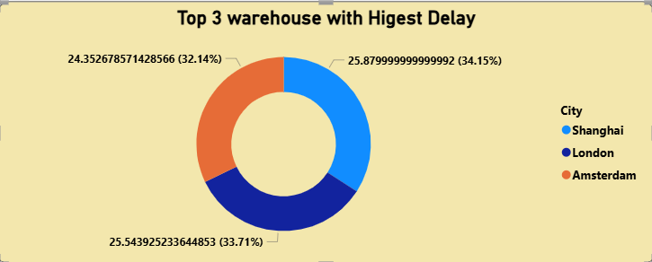
Task 4 – Warehouse Performance Analysis.
1. Find the top 3 warehouses with the highest average delay in shipments dispatched.
Findings :
The top 3 warehouses in Shanghai, London, and Amsterdam have the highest average delays (25.87, 25.54, and 25.35 respectively). This suggests these locations may be facing operational challenges, high workload, or slower processing, which is affecting delivery times.

Slide 20
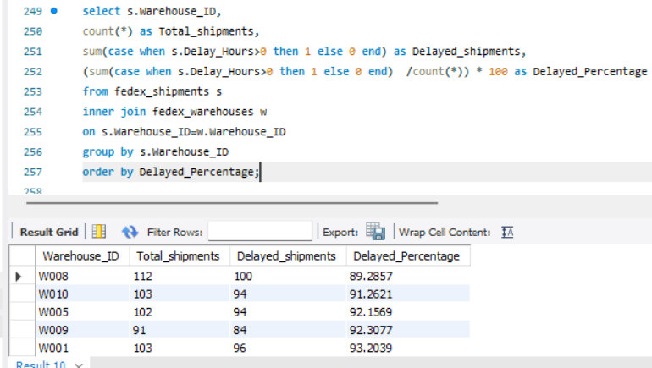
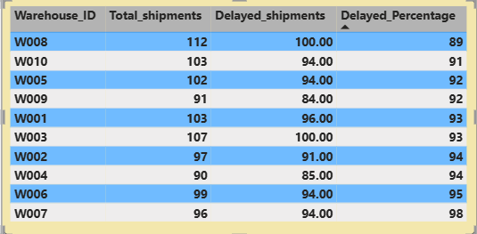
Task 4 – Warehouse Performance Analysis.
2. Calculate total shipments vs delayed shipments for each warehouse.
Findings :
Warehouse W008 has the highest shipment volume (112 shipments) but also a very high delay rate (~89%), indicating capacity or process issues.
Warehouses W001, W003, and W002 show delay percentages above 93%, suggesting consistently poor on-time performance.
Warehouse W007 records the worst delay performance, with nearly 98% of shipments delayed, making it the most critical warehouse to address.

Slide 21
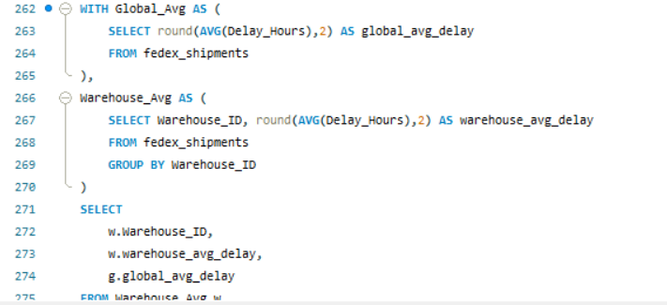
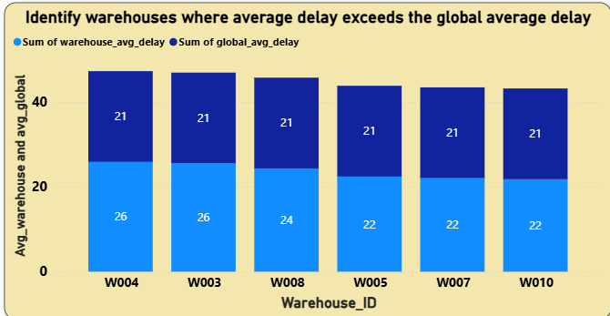
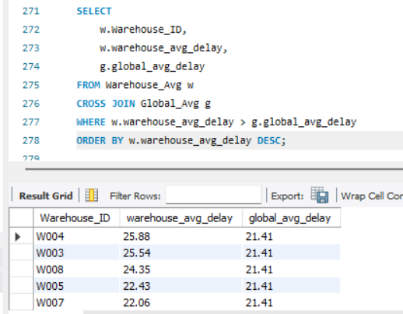
Task 4 – Warehouse Performance Analysis.
3. Use CTEs to identify warehouses where average delay exceeds the global average delay.
Findings :
The global average delay is approximately 21.41 hours across all shipments.
Warehouses W004, W003, and W008 have the highest average delays (above 24 hours), significantly exceeding the global average.
Warehouses W005 and W007 ,W010 ,also exceed the global average delay, indicating consistent performance issues at these locations

Slide 22
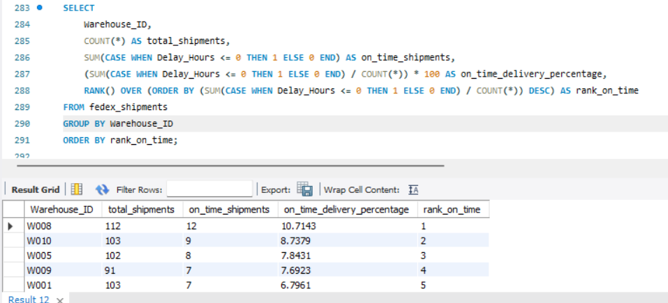
Task 4 – Warehouse Performance Analysis.
4. Rank all warehouses based on on-time delivery percentage.
Findings :
Warehouse W008 ranks 1st with the highest on-time delivery rate (~10.7%), performing best among all warehouses.
Warehouses W010 and W005 follow in 2nd and 3rd place, though their on-time rates remain below 9%, indicating overall low punctuality.
Warehouse W007 ranks 10th with the lowest on-time delivery percentage (2..08%), highlighting the weakest performance in meeting delivery timelines

Slide 23
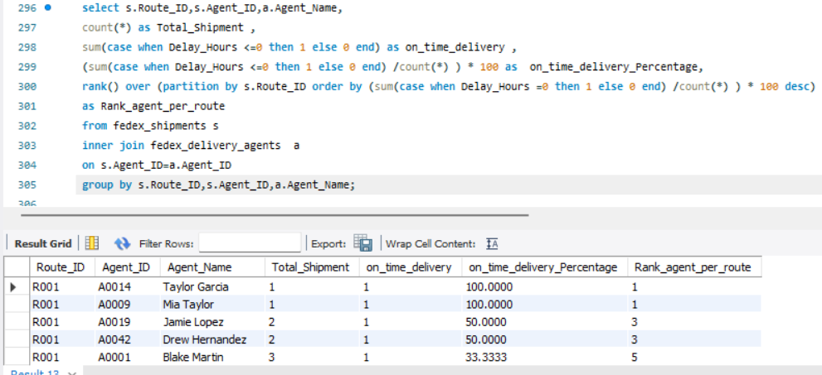
Task 5 – Delivery Agent Performance
1. Rank delivery agents (per route) by on-time delivery percentage.
Findings –
On Route R001, Taylor Garcia and Mia Taylor rank 1st with 100% on-time delivery, showing perfect performance on this route.
Jamie Lopez and Drew Hernandez achieve 50% on-time delivery, placing them in the middle tier for the same route.
Blake Martin ranks lowest 5th with only 33.33% on-time delivery, indicating the weakest performance on Route R001

Slide 24
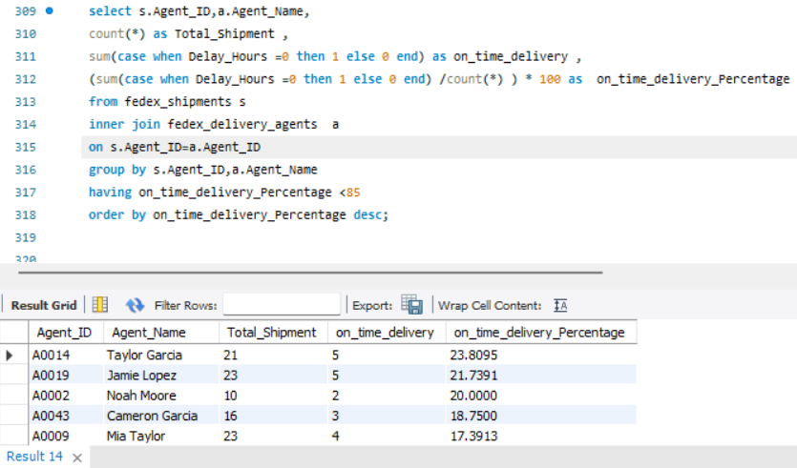
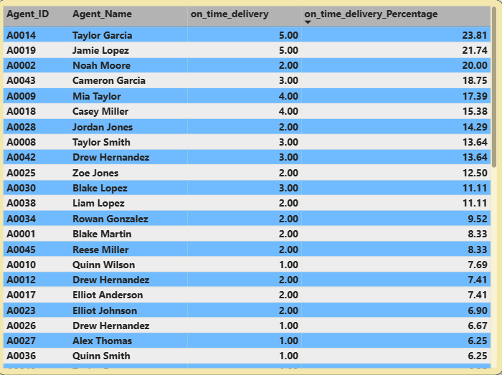
Task 5 – Delivery Agent Performance
2.. Find agents whose on-time % is below 85%.
Findings:
All agents listed have on-time delivery rates below 85%, with performance ranging from 23.81% to 3.70%, showing widespread underperformance.
Taylor Garcia (23.81%) and Jamie Lopez (21.74%) are the highest performers in this group, while Noah Gonzalez (3.70%) have the lowest on-time delivery rates.
Low shipment volumes significantly affect percentages, meaning even one delayed delivery greatly reduces an agent’s on-time performance, indicating results may be skewed.

Slide 25
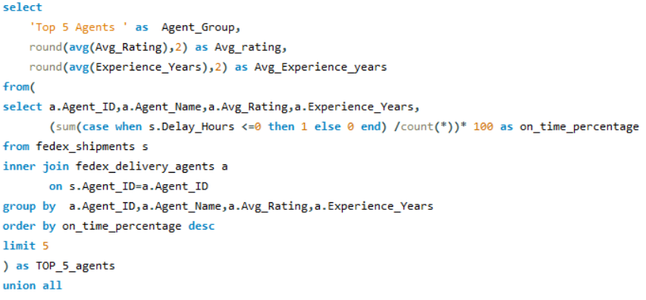
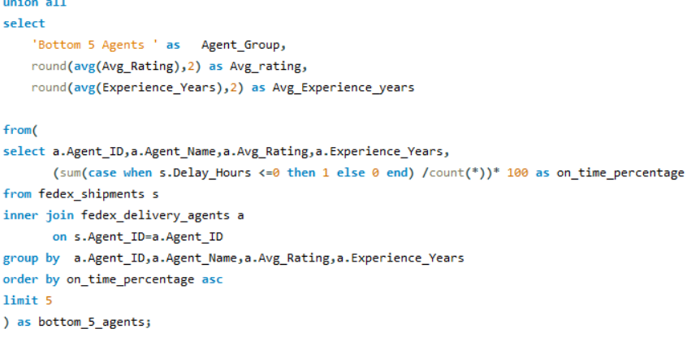
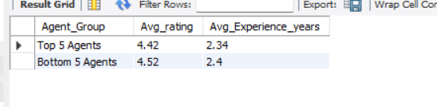
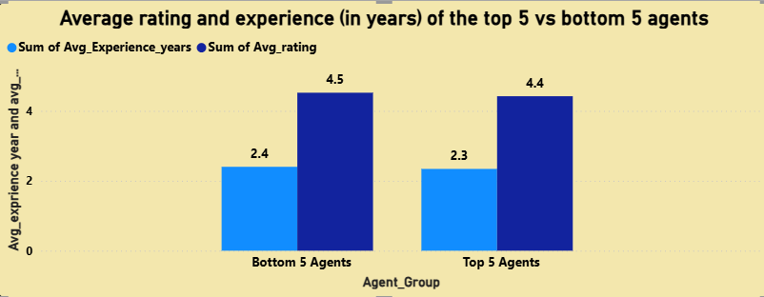
Task 5 – Delivery Agent Performance
3. Compare the average rating and experience (in years) of the top 5 vs bottom 5 agents using subqueries.
Findings:
The top 5 agents have an average rating of 4.42 and 2.34 avg_years of experience.
The bottom 5 agents surprisingly have a higher avg_rating of 4..52 and 2.40 avg_years of experience.

Slide 26
Task 5 – Delivery Agent Performance
4. Suggestion: training or workload balancing strategies for low-performing agents based on insights.
Suggestion:
Targeted Training Programs: Provide skill development and route management training for low-performing agents, especially those with on-time delivery below 50%.
Workload Balancing: Reassign deliveries to ensure agents with consistently low on-time percentages handle fewer shipments, reducing risk of delays.
Mentorship & Best Practices: Pair low-performing agents with top performers (e.g., Taylor Garcia, Mia Taylor) to adopt efficient delivery practices.
Performance Monitoring: Implement real-time tracking dashboards to monitor on-time delivery rates and provide immediate feedback.
Incentive Programs: Introduce performance-based incentives for agents who improve on-time delivery rates, motivating consistent improvement.

Slide 27
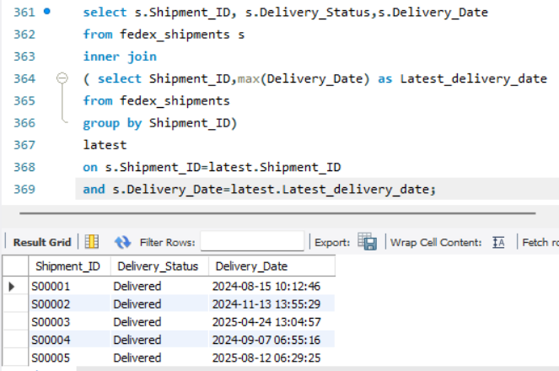
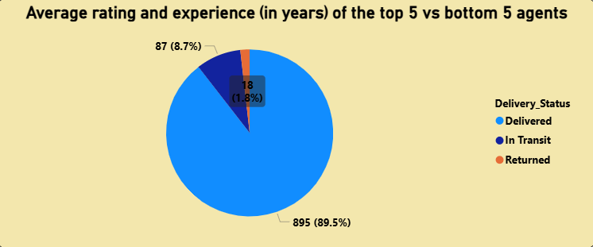
Task 6 – Shipment Tracking Analysis
1. For each shipment, display the latest status (Delivered, In Transit, or Returned) along with the latest Delivery_Date.
Findings:
Each shipment is shown with its most recent status and delivery date, ensuring only the latest update per shipment is reported.
The majority of shipments are marked as “Delivered”, with a much smaller proportion still In Transit or Returned, indicating overall successful delivery completion.

Slide 28
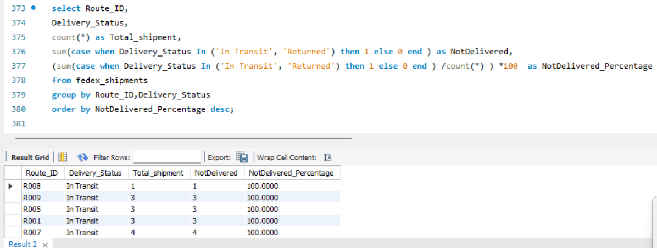
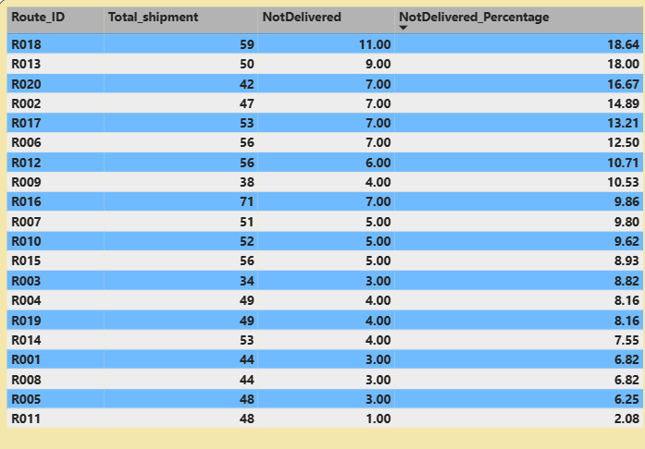
Task 6 – Shipment Tracking Analysis
2 Identify routes where the majority of shipments are still “In Transit” or “Returned”.
Findings:
Route R020 shows a relatively high proportion of undelivered shipments, with 16.67% (7 out of 42 shipments) still marked as “In Transit” or “Returned”, indicating notable delivery delays or return issues compared to most other routes.

Slide 29
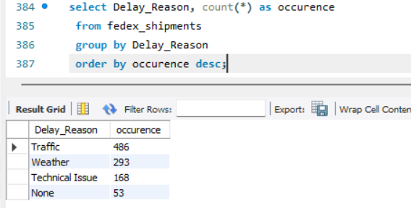

Task 6 – Shipment Tracking Analysis
3. Find the most frequent delay reasons (if available in delay-related columns or flags).
Findings:
Traffic is the most frequent delay reason, with 486 occurrences, making it the primary cause of shipment delays.
Weather is the second most common reason, accounting for 293 occurrences, indicating significant environmental impact on deliveries.
Technical Issues contribute to delays less frequently, with 168 occurrences.
No delay reason recorded appears 53 times, suggesting either minor issues or missing delay information.

Slide 30

Task 6 – Shipment Tracking Analysis
4. Identify orders with exceptionally high delay (>120 hours) to investigate potential bottlenecks.
Findings:
shipments experienced exceptionally high delays of over 230 hours.
The maximum delay recorded was 238.6 hours, affecting multiple orders.
All delayed shipments were eventually delivered, indicating process inefficiencies rather than delivery failure.

Slide 31


1. Average Delivery Delay per Source_Country
Task 7 – KPI Reporting
Average Delivery Delay In hours
20.87 hours
Shipment Leader
USA — 144 shipments
Highest Average Delay Country
UAE — 41.03 hours
Top Delay Countries
UAE, Turkey, China, Singapore, UK Range: 29–41 hours
Bottom Delay Countries Japan ,Canada
Range: 9.72-— 11.94 hours
Findings:The UAE has the highest delay (41.03 hrs) despite moderate volume, while the USA handles the most shipments (144) with significantly higher efficiency than the high-delay leaders like Turkey and China.

Slide 32


Task 7 – KPI Reporting
2. On-Time Delivery % = (Total On-Time Deliveries / Total Deliveries) * 100.
Best Performing Route
R015 — 17.86% OTD
Route With 0% OTD
R009 — 0% On-Time
Avg of OTD
9%
Avg_On-Time Delivery %
9.21%
Findings:
The overall system maintains an alarmingly low 9.21% On-Time Delivery rate.
Route R015 (Netherlands) is the most reliable path, achieving the highest OTD rate of 17.86%.
Performance is so poor that Route R009 has recorded a 0% On-Time rate, while even the best routes struggle to exceed an 18% success threshold.

Slide 33


short 1 line
3. Average Delay (hours) per Route_ID
Task 7 – KPI Reporting
Avg Delay hours (Across All Routes)
23.6 hours
Top Delay Routes
R002 – 41.03 hours R007 – 34.01 hours
Moderate Delay Routes
R005-29.86 hours
R004 -25.88 hours
Bottom Delay Routes
R001 – 6.82 Hours
R009 – 9.72 Hours
Findings:
Route R002 is the most significant bottleneck in the network, with a critical average delay of 41.04 hours.
There is a massive gap in efficiency across the network, with the worst route (R002) experiencing over 6x more delay than the most efficient path, Route R001, which averages only 6.82 hours.
The overall average delay across all routes in the network is 23.6 hours, serving as a benchmark for identifying underperforming high-risk routes like R007 (34.01 hrs) and R020 (32.80 hrs).

Slide 34




Task 7 – KPI Reporting
4. Warehouse Utilization % = (Shipments_Handled / Capacity_per_day) * 100.
Highest Utilization Warehouse_ID
W010 — 0.11%
Lowest Utilization Warehouse
W003 — 0.03%
Network Avg
Utilization
0.05%
Warehouses Below 0.05% Utilization
5 Warehouses
W001,W003,W007,W008,W009
Findings:
The entire logistics network is operating at a critically low average utilization of just 5.99%, leaving 88–96% of total capacity unused.
Warehouse W010 is the most active facility with 0.11% utilization, which is more than triple the activity level of the least utilized facility, W003 (3.43%).
A significant portion of the infrastructure is dormant, with 4 individual warehouses operating below a minimal 5% utilization threshold.

Slide 35
Key Insights:
1.Express deliveries experience higher average delays (23 hours) than Standard deliveries (21 hours).
2.Certain routes, like R003 (Singapore → Hong Kong) and R009, show extremely low efficiency and very high delay rates, indicating critical operational bottlenecks despite short distances.
3.Warehouses W007, W003, and W008 consistently show high shipment delays, with W007 having the lowest on-time delivery rate (2.08%), highlighting major operational inefficiencies.
4.Despite experience and ratings being similar across agents, on-time delivery performance varies widely, with some highly rated agents still underperforming.
5.Traffic and weather are the primary causes of shipment delays, with certain routes like R020 showing a higher proportion of undelivered shipments, indicating process bottlenecks.
6.The logistics network shows extremely low on-time delivery (9.21%) and underutilized warehouse capacity (average 5.99%), indicating major inefficiencies across routes and facilities.

Slide 36
Recommandation:
1.Focus on optimizing logistics for Express shipments to reduce delays and meet tighter delivery timelines.
2.Prioritize process optimization and resource allocation for the least efficient routes to reduce delays and improve overall transit reliability.
3.Focus on process optimization and capacity management at underperforming warehouses to improve punctuality and reduce delays.
4.Provide targeted training and performance monitoring for underperforming delivery agents to improve consistency in on-time deliveries.
5.Implement route optimization and proactive planning to mitigate traffic and weather impacts, especially on high-delay routes, to improve delivery timeliness.
6.Prioritize improving route performance and optimizing warehouse utilization to enhance overall delivery efficiency and reduce delays.

Slide 37
Thank You

